Slide 1
Smart Ordering Service
For Sales & Distribution
2012

Slide 2
Smart Ordering Service
Sales Rep
Consumers
Smart
Ordering
Service
Institutions
Distributor
Hotels, Restaurants,
Corporates etc.
Retailer
Convenient Stores,
Chains
Notes:
2

Slide 3
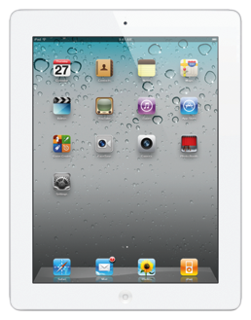
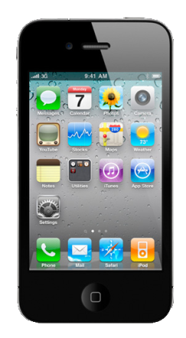
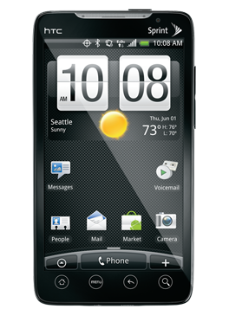
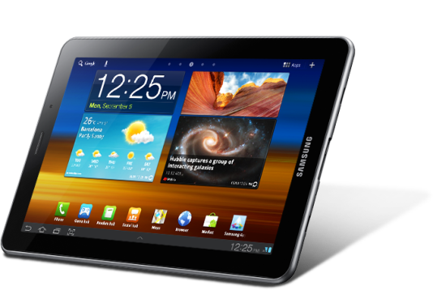
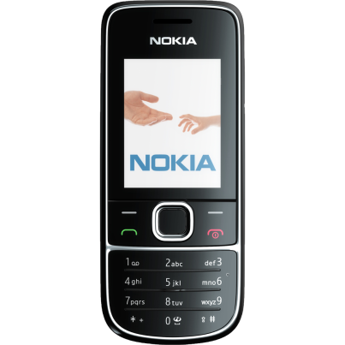
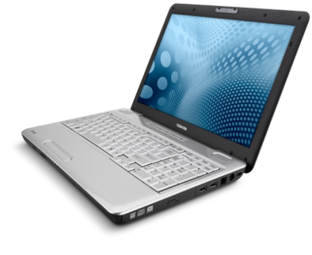
Order Entry
Orders can be captured via…
Tablets
Mobile Phones
PC / Laptops
Notes:
3

Slide 4
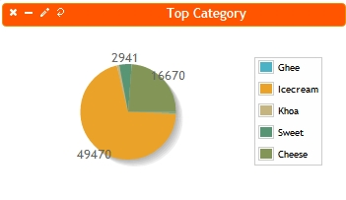
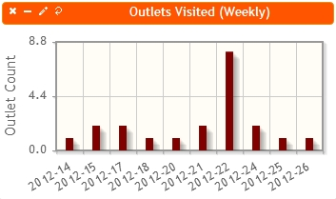
Business Processes
1
2
3
Order Capture
Order Processing
Dashboards
Flexible
Pricing
Order
fulfillment
Schemes
Returns
Up-selling
suggestions
Inventory
Notes:
4

Slide 5
Benefits
Efficient Order processing (Time& Cost)
Multi-Channel support
Real-time Order analysis
Communicate latest price, schemes, inventory
Measure effectiveness of new schemes
Notes:
5

Slide 6
Notes:
6

